Slide 1



Social Buzz Sentiment Analysis

Slide 2


Today's agenda
Project recap
Problem
The Analytics Team
Process
Insights
Summary

Slide 3

Social Buzz is a fast growing technology unicorn that need to adapt quickly to it's global scale. Accenture has begun a 3 month POC focusing on these tasks:
An audit of Social Buzz's big data practice
Recommendations for a successful IPO
Analysis to find Social Buzz's top 5 most popular categories of content
Project Recap

Slide 4

Problem
In this analysis, we must take into account the vast quantity of data that Social Buzz handles.
We're dealing with over 100,000 posts daily and 36,500,000 pieces of content annually!
To better concentrate on what is driving the most engagement on the platform, we've highlighted the top 5 most popular categories.

Slide 5






Andrew Fleming
Chief Technology Architect
The Analytics Team
Marcus Rompton
Senior Principal
Syahril Dimas Sabirin
Data Analyst

Slide 6
Data Understanding
This involves studying the data.
Process
1
Data Modeling
Determining the relevant data from the given sets that should be incorporated into the final dataset.
2
3
Data Preparation
Getting the data ready for analysis.
4
Data Analysis
Looking into the data.
5
Data Visualization
Using graphics to reveal insights from the data.

Slide 7

Insights
1897
REACTIONS FROM THE ANIMALS
ANIMALS
THE MOST POPULAR CATEGORIES
16
UNIQUE CATEGORIES
DECEMBER
THE MONTH
WITH THE MOST POSTS
2020
THE YEAR
WITH THE HIGHEST OVERALL REACTIONS
56.2%
TOTAL POSITIVE REACTIONS
RATIO

Slide 8
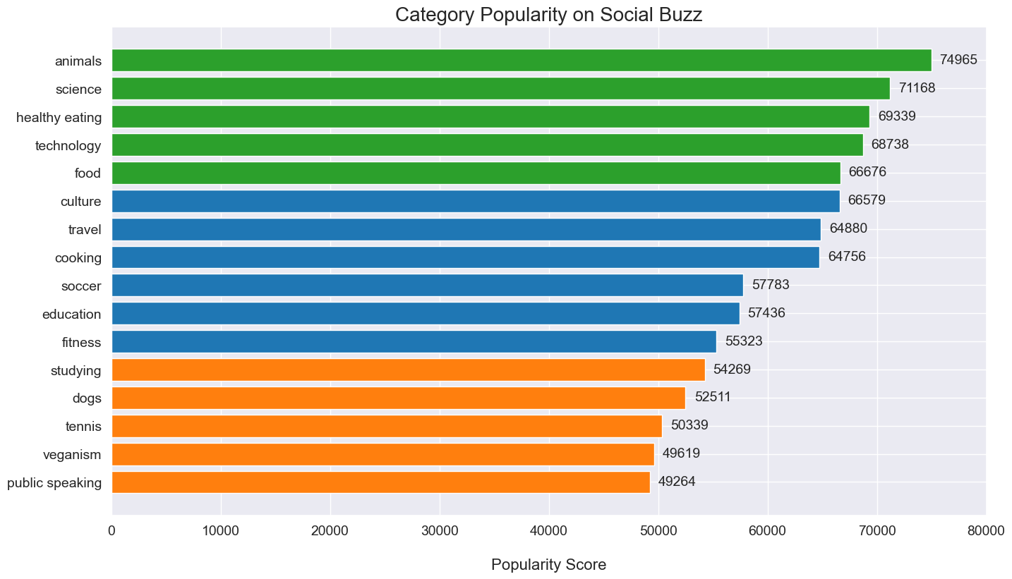

Slide 9
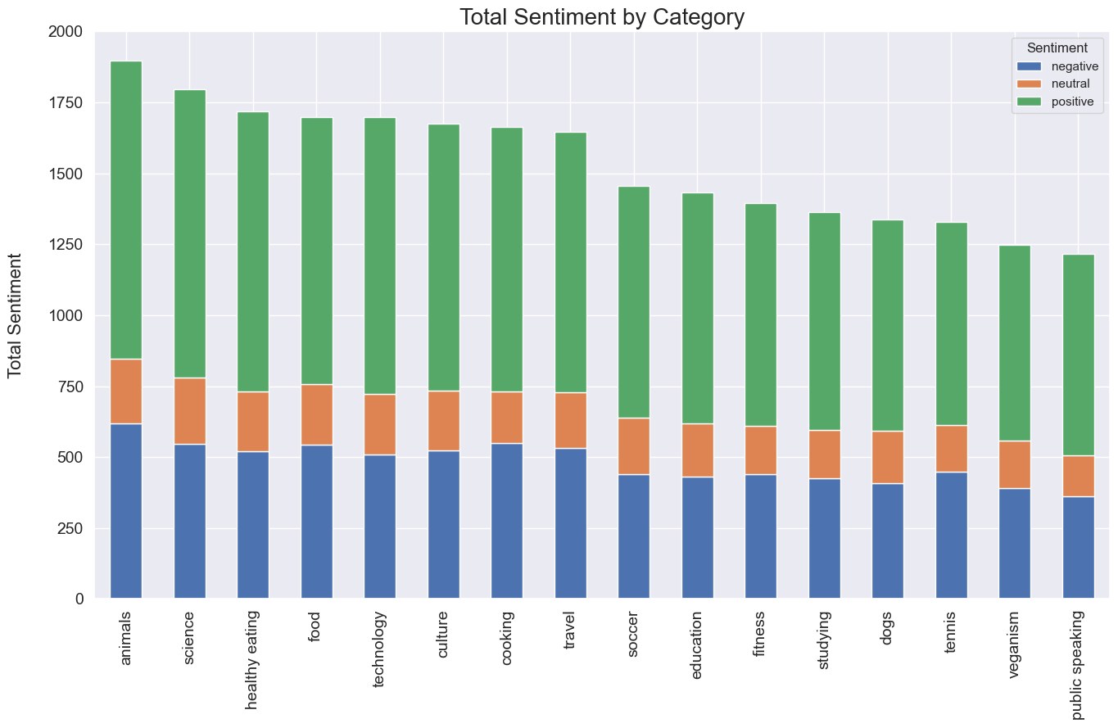

Slide 10
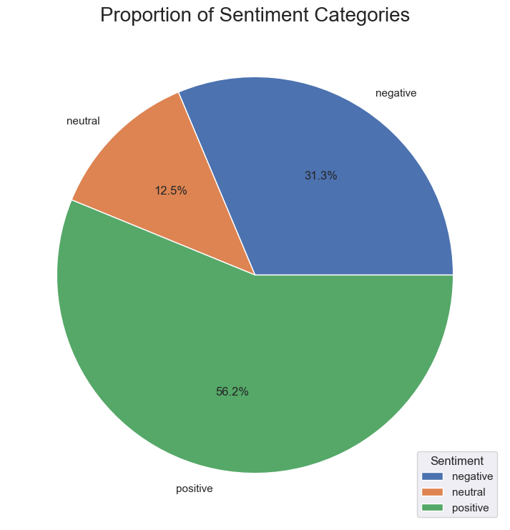

Slide 11

Focus on High Sentiment Categories
It would be beneficial to focus on these categories when developing marketing strategies and product offerings.
Improve Negative Sentiment Categories
It would be advisable to improve the content and marketing efforts for these categories.
Utilize Sentiment Analysis for Real-time Analysis and Insights
It can be very helpful when identifying issues that need to be addressed right away.
Summary

Slide 12
Thank you!
ANY QUESTIONS?

